Slide 1
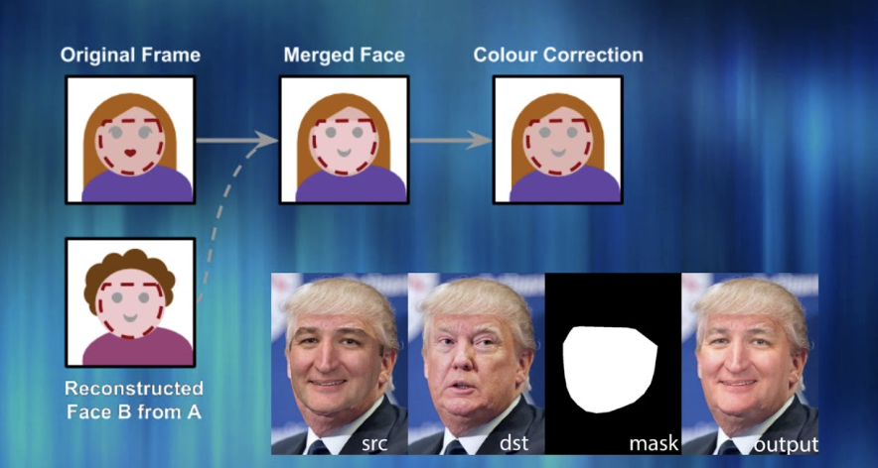

Variational Autoencoders, Generative Adversarial Networks, Multi-task Deep Learning, Multi-view Deep Learning. Various Applications - speech, text, image and video
MODULE-6
Variational Autoencoders, Generative Adversarial Networks, Multi-task Deep Learning, Multi-view Deep Learning. Various Applications - speech, text, image and video

Slide 2
Autoencoders
An autoencoder is a type of artificial neural network used to learn data encodings in an unsupervised manner.
The aim of an autoencoder is to learn a lower-dimensional representation (encoding) for a higher-dimensional data, typically for dimensionality reduction, by training the network to capture the most important parts of the input image.

Slide 3
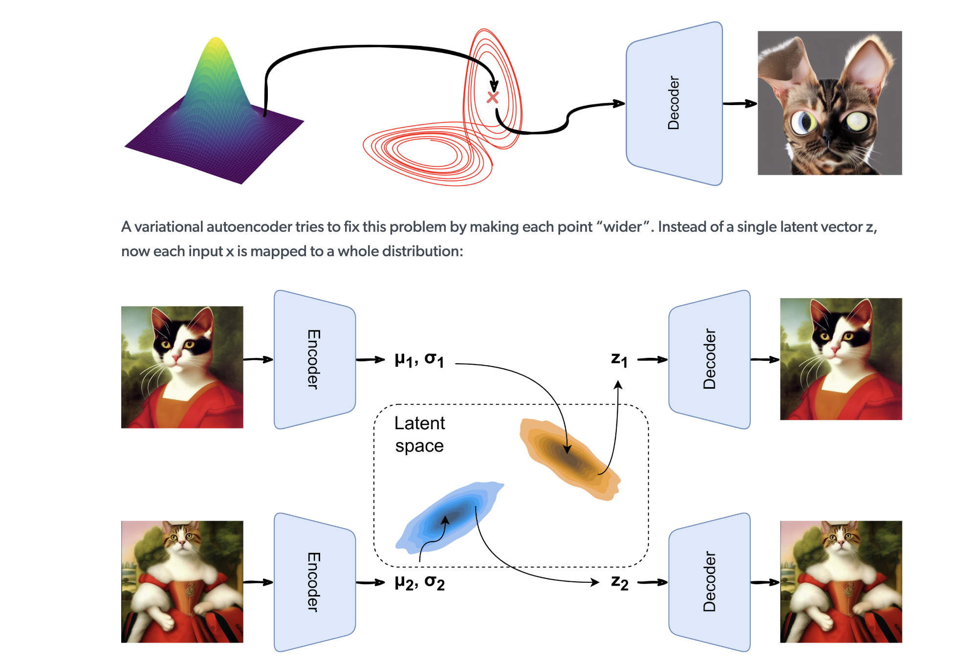

Slide 4
Autoencoders differ from General Data Compression
Autoencoders are data-specific
i.e., only able to compress data similar to what they have been trained on
This is different from, say, MP3 or JPEG compression algorithm Which make general assumptions about "sound/images”, but not about specific types of sounds/images
Autoencoder for pictures of cats would do poorly in compressing pictures of trees
Because features it would learn would be cat-specific
Autoencoders are lossy
which means that the decompressed outputs will be degraded compared to the original inputs (similar to MP3 or JPEG compression).
This differs from lossless arithmetic compression
Autoencoders are learnt

Slide 5
Need for Autoencoders and VAE
The idea is to compress the data so that the same amount of information can be represented by fewer bits.
This also helps with the problem of the curse of dimensionality.
A dataset with many attributes is different to train with because it tends to overfit the model.
Hence dimensionality reduction techniques need to be applied before the dataset can be used for training.
Autoencoder (AE) and Variational Autoencoder (VAE) come into play.
They are end-to-end networks that are used to compress the input data. Both Autoencoder and Variational Autoencoder are used to transform the data from a higher to lower-dimensional space, essentially achieving compression.

Slide 6
Architecture
Autoencoders consist of 3 parts:
1. Encoder: A module that compresses the train-validate-test set input data into an encoded representation that is typically several orders of magnitude smaller than the input data.
2. Bottleneck: A module that contains the compressed knowledge representations and is therefore the most important part of the network.
3. Decoder: A module that helps the network“decompress” the knowledge representations and reconstructs the data back from its encoded form. The output is then compared with a ground truth.

Slide 8
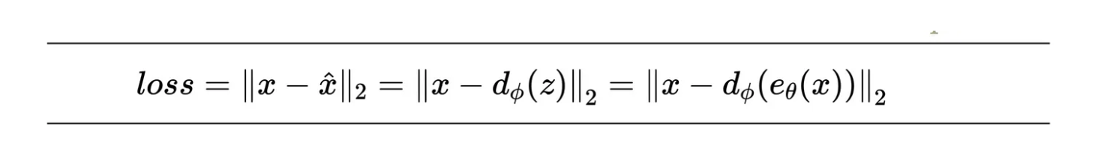
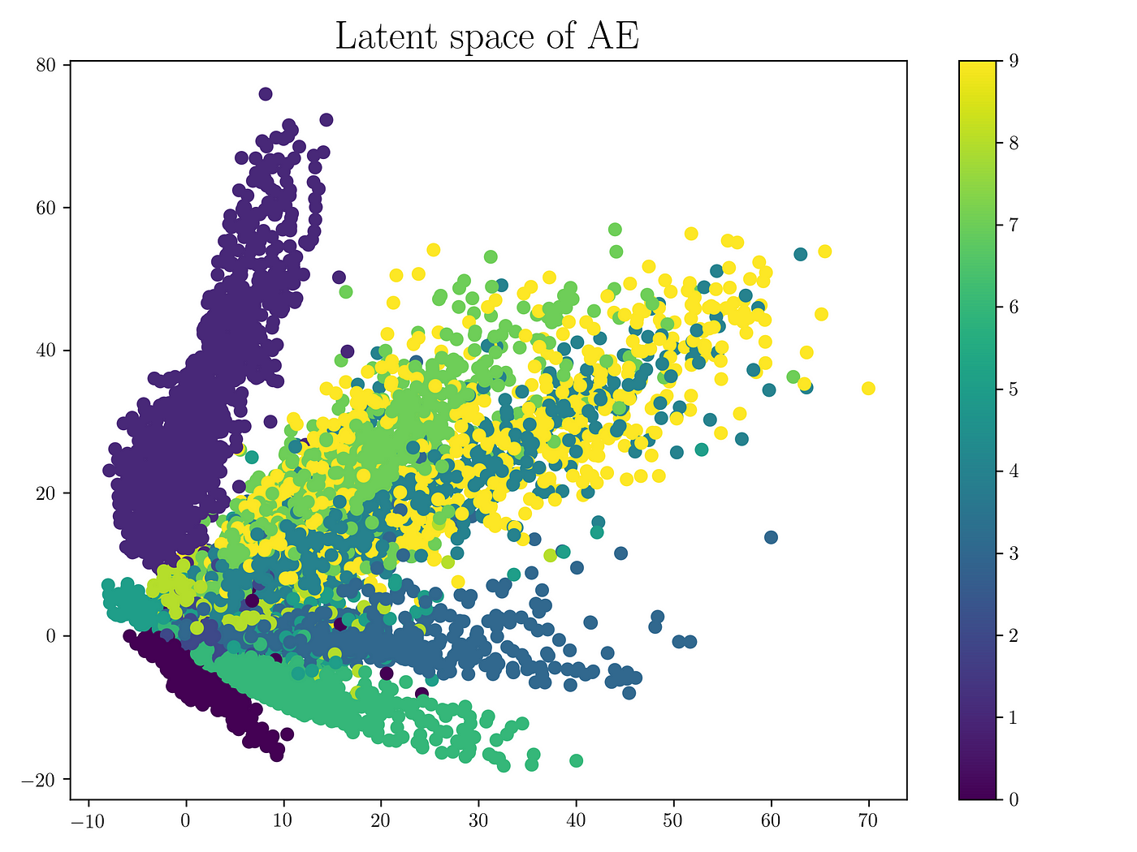
Loss function
The entire encoder-decoder architecture is collectively trained on the loss function which encourages that the input is reconstructed at the output.
A very low dimensional latent space is represented in such a way that the maximum compression is achieved and the error also should be small.
Reducing the dimension of the latent space beyond a certain value will result in a significant loss of information.

Slide 9
Latent space is not regularized
AE is capable of compressing the valid inputs to a fewer bits essentially ignoring the redundancy
The regions which do not belong to any cluster will generate garbage output.
Once the network is trained, and the training data is removed, we have no way of knowing if the output generated by the decoder from a randomly sampled latent vector is valid or not.
Hence AE is mainly used for compression.
The power of AE comes with its non-linearity.
Adding non-linearity (such as nonlinear activation functions, and more hidden layers) makes AE capable to learn rather powerful representations of the input data in lower dimensions with much less information loss.
ALSO the decoder can not be used to generate valid input data from latent from vectors sampled from the latent space.
The complete latent space does not have the generative capability.

Slide 10
Why Variational Autoencoder?
Variational autoencoder addresses the issue of non-regularized latent space in autoencoder and provides the generative capability to the entire space.
The encoder in the AE outputs latent vectors.
Instead of outputting the vectors in the latent space, the encoder of VAE outputs parameters of a pre-defined distribution in the latent space for every input.
The VAE then imposes a constraint on this latent distribution forcing it to be a normal distribution.
This constraint makes sure that the latent space is regularized.

Slide 11

Variational Autoencoders
Standard and variational autoencoders learn to represent the input just in a compressed form called the latent space or the bottleneck.
Therefore, the latent space formed after training the model is not necessarily continuous and, in effect, might not be easy to interpolate.

Slide 12
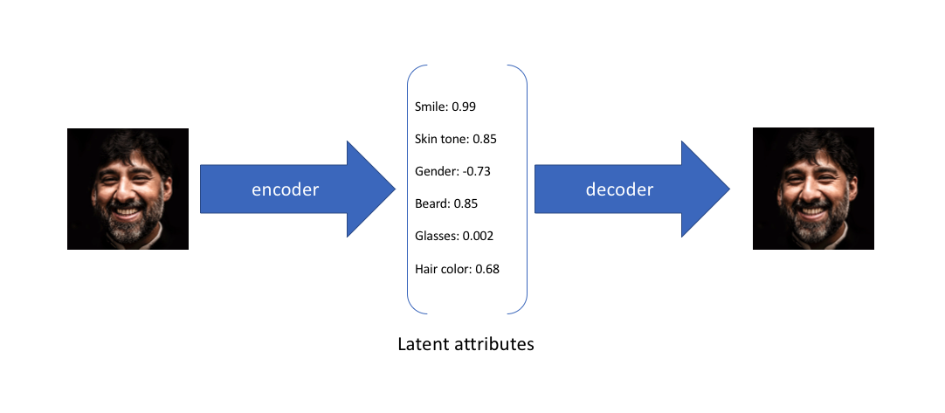
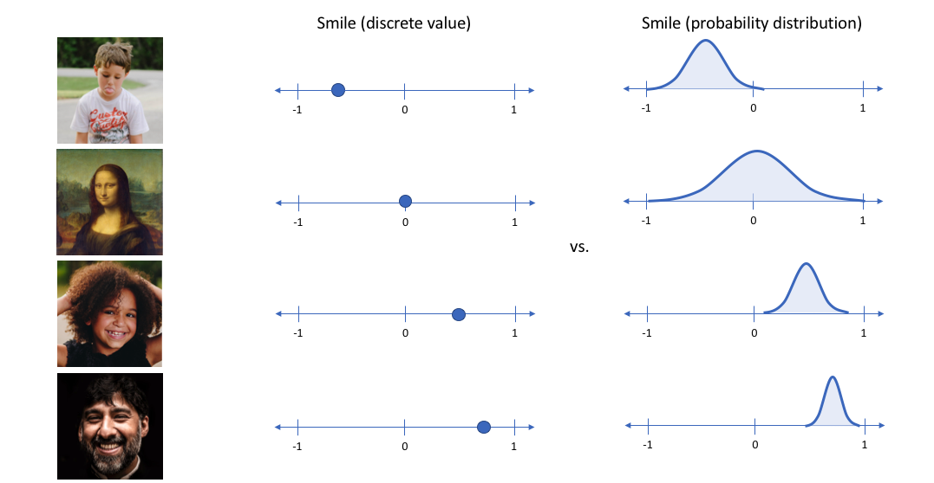

EXAMPLE
1,080 × 1,080

Slide 13
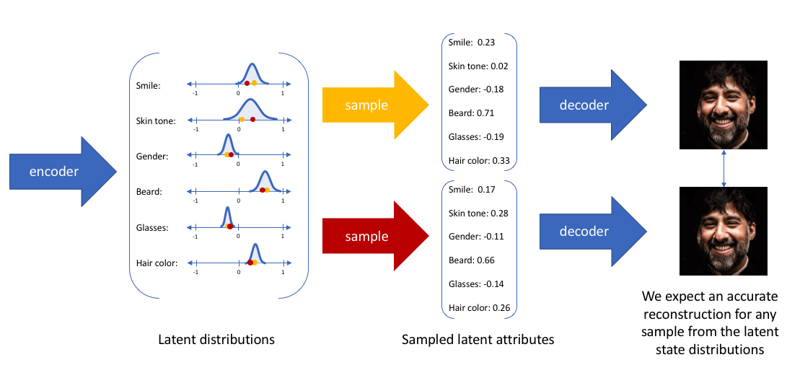
HOW AN IMAGE IS RECONSTRUCTED?

Slide 14
VAE
The encoder is a set of convolutional blocks followed by pooling modules that compress the input to the model into a compact section called the bottleneck.
The bottleneck is followed by the decoder that consists of a series of upsampling modules to bring the compressed feature back into the form of an image.
In case of simple autoencoders, the output is expected to be the same as the input with reduced noise.
However, for variational autoencoders it is a completely new image, formed with information the model has been provided as input.

Slide 15
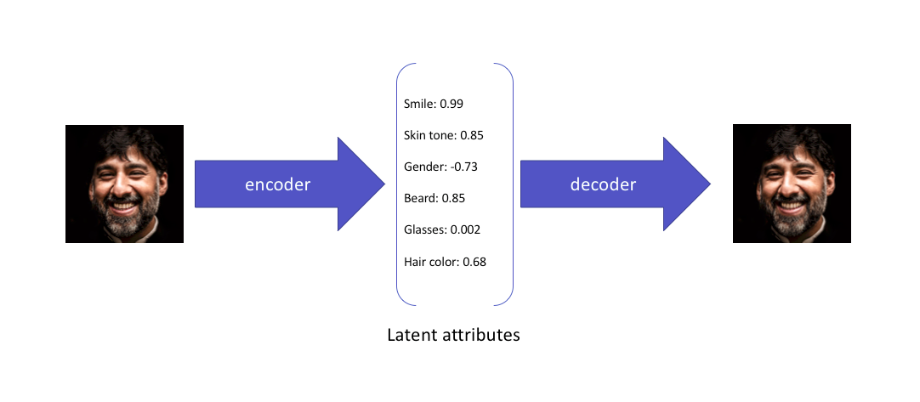

Slide 16
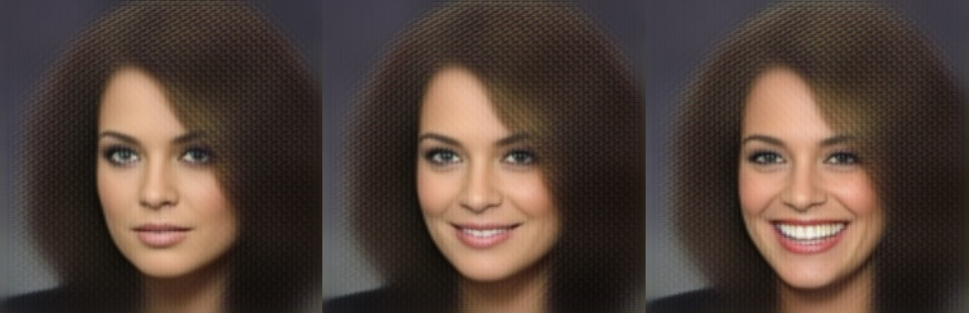
VAE does not simply try to embed the data in the latent space, but instead to characterize the latent space as a feature landscape, a process which conditions the latent space to be sufficiently well-behaved for data generation.
Not only can we use this landscape to generate new data, but we can even modify the salient features of input data.
We can control, for example, not only whether a face in an image is smiling, but also the type and intensity of the smile:

Slide 17
Encoder
The encoder network compresses high dimensional inputs into lower-dimensional coordinates of the bottleneck layer
The encoder consists of one or more layers of neural networks.
These layers progressively reduce the dimensionality of the input data.
Lower layers detect simple(corners,edges) while higher layers detect complex patterns
Encoder compresses the input image into a much smaller representation called the “encoding” or “latent space.”
This encoding is a compressed representation of the original image, containing only the most essential features.

Slide 18
Decoder
Finally, the decoder is a set of upsampling and convolutional blocks that reconstructs the bottleneck's output.
Since the input to the decoder is a compressed knowledge representation, the decoder serves as a “decompressor” and builds back the image from its latent attributes.

Slide 19
Bottleneck
The most important part of the neural network, and ironically the smallest one, is the bottleneck.
The bottleneck exists to restrict the flow of information to the decoder from the encoder, thus,allowing only the most vital information to pass through.
It helps us form a knowledge-representation of the input because the maximum information is captured
Thus, the encoder-decoder structure helps us extract the most from an image in the form of data and establish useful correlations between various inputs within the network.
A bottleneck as a compressed representation of the input further prevents the neural network from memorising the input and overfitting on the data.
As a rule of thumb, remember this: The smaller the bottleneck, the lower the risk of overfitting.
Very small bottlenecks would restrict the amount of information storable, which increases the chances of important information slipping out through the pooling layers of the encoder.

Slide 20
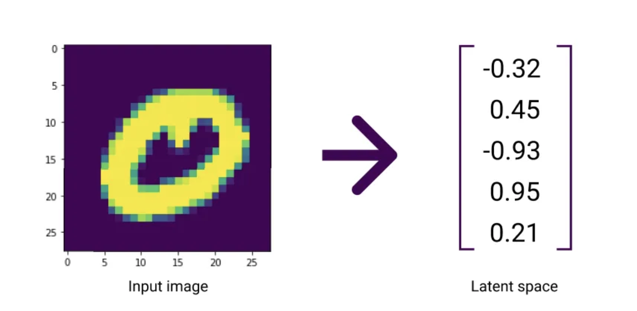
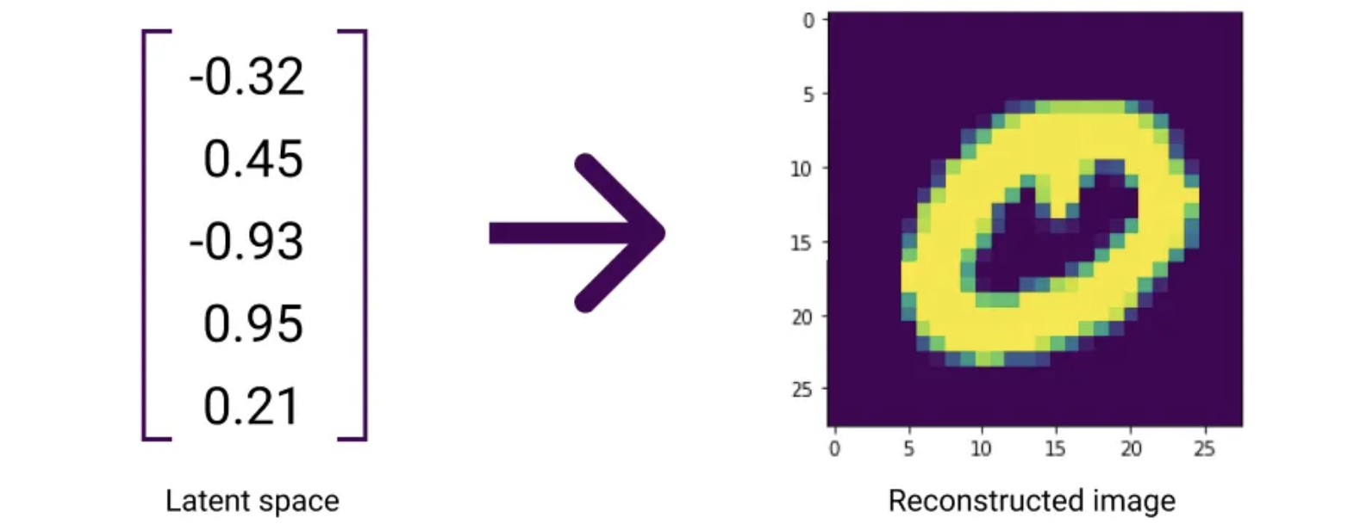
Encoding and Decoding
The VAE has to teach itself how to properly map from an input image to a latent space.
Because they’re really good at learning such mappings, we typically train an AI algorithm called a neural network to work as a VAE.

Slide 21
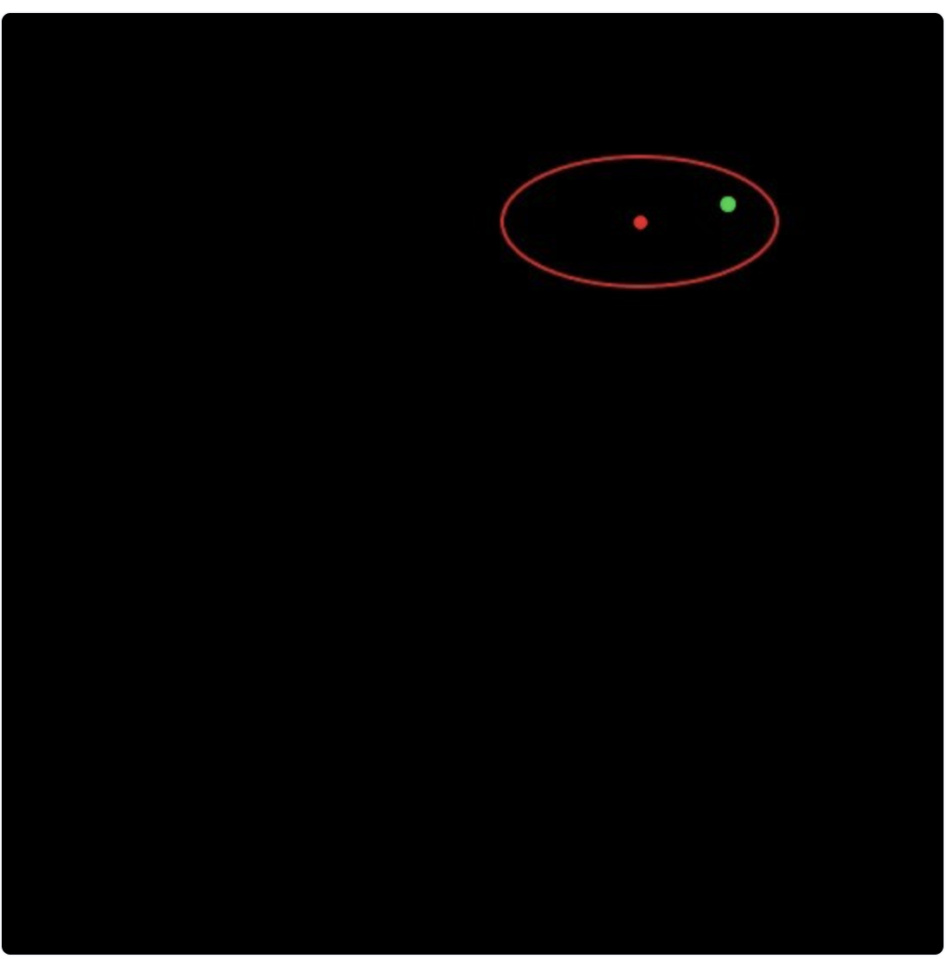
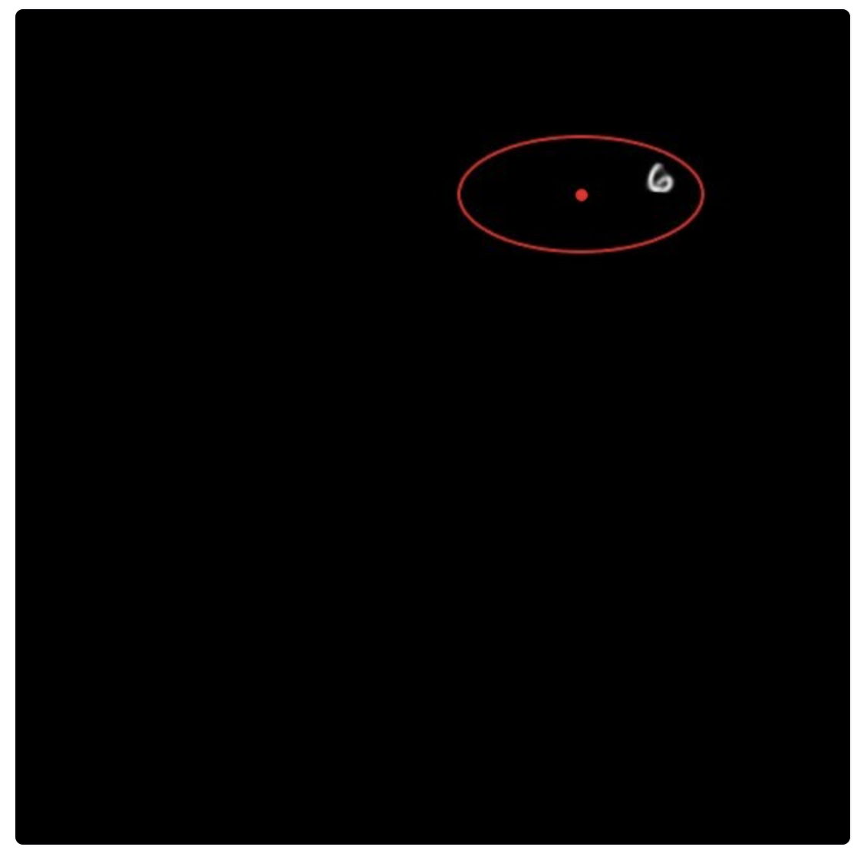
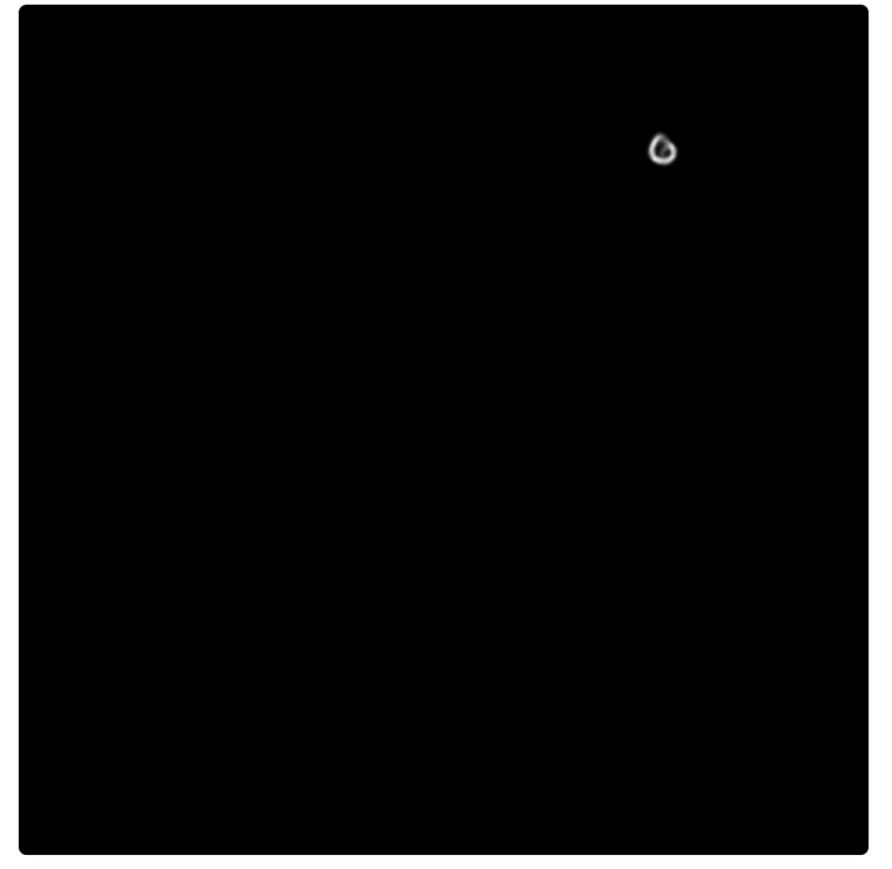
Example: VAE with MNIST data
Input: Image of 6
A sample from this distribution (green color) is considered and pass the resulting data point into the decoder
No loss as the image is similar to 6 when seeing the centre
Decoded Image of Randomly Sampled Point
If input iamge =1, Decoded Image of Randomly Sampled Point is shown
In this case loss is huge
Distribution of Encoded Image (Red), Randomly Sampled Point (Green)

Slide 22
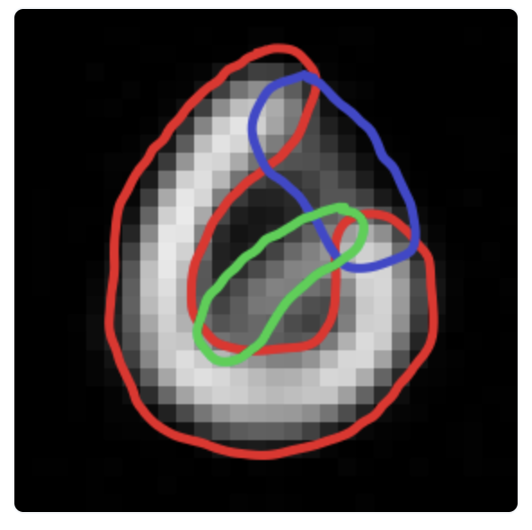
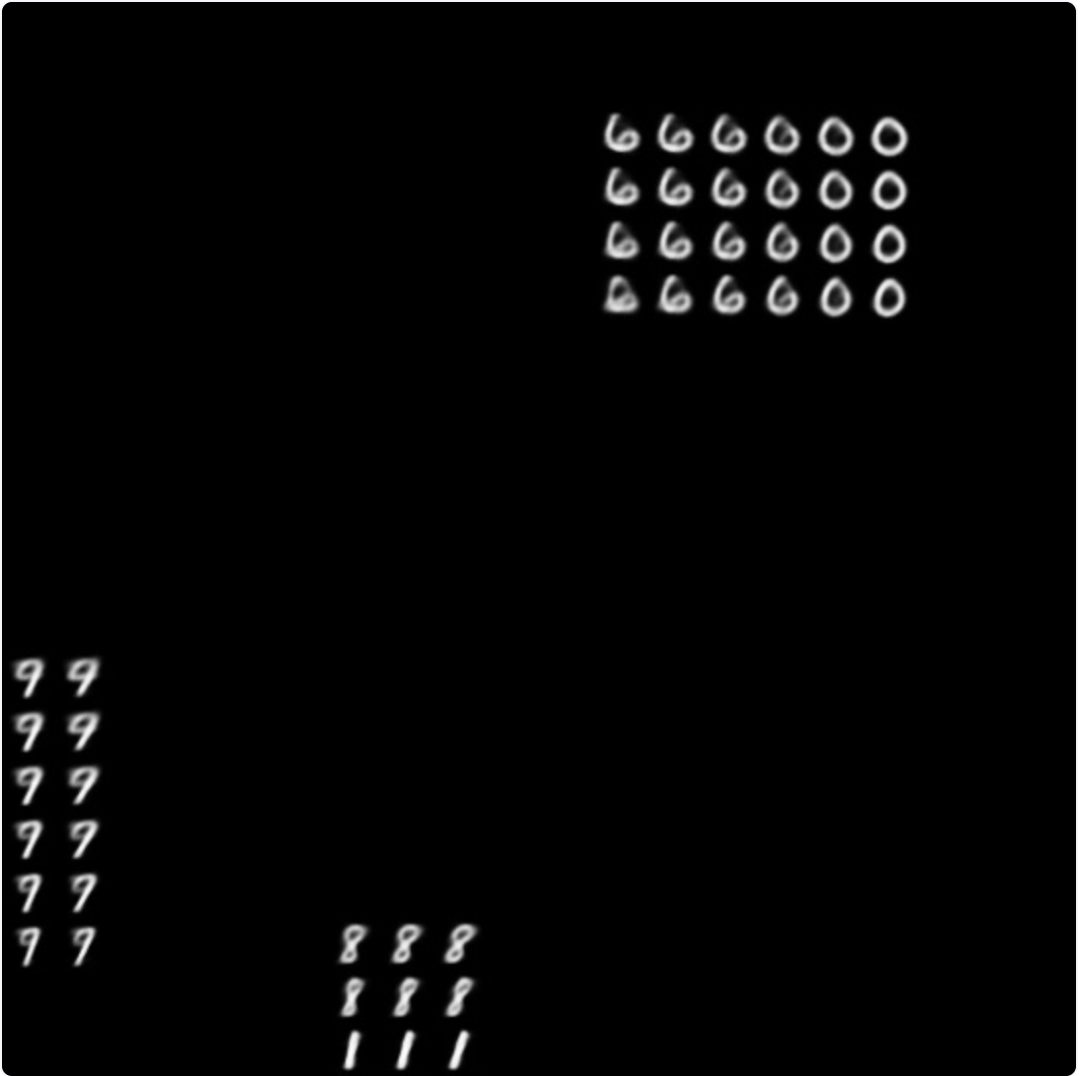
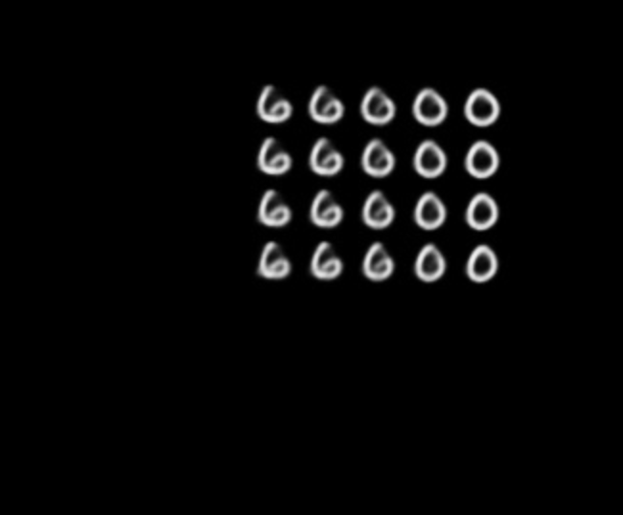
How training is done?
Input : 0 image
Variational Autoencoder will learn to map intermediate points to images that could reasonably be interpreted as “6” or “0”.
The decoding of the intermediate points yield snapshots of continuous transformations from one shape to another.
Similar images will be clumped and the rest of the images will be pushed from the consideration of the training

Slide 23
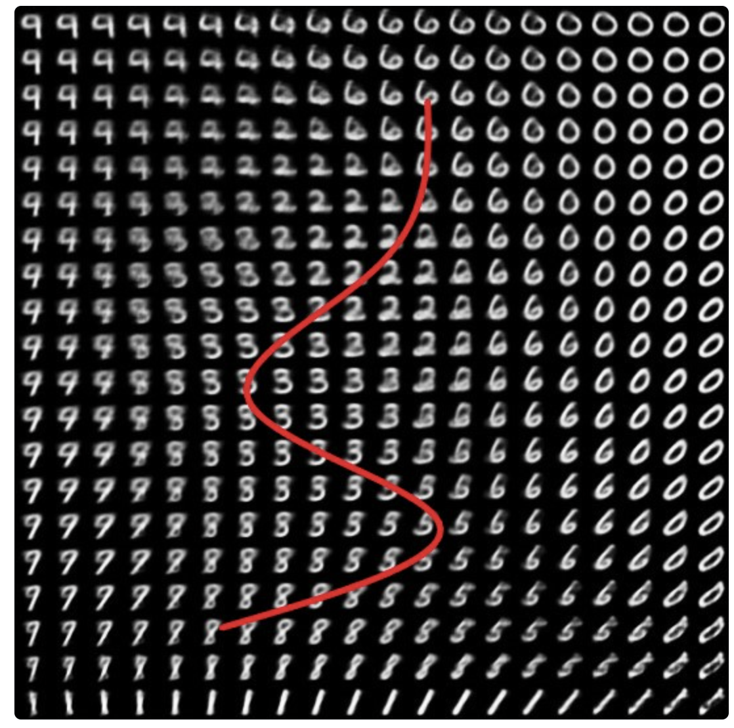
Each patch represents a specific feature or variation, like different styles of a digit. (example 3 5 6, 8) (1,7,9)
Continuous and smooth transition is required to make the latent space to work properly.
Due to this, realistic outputs are produced as we travel through the entire latent space
See this, from 6,2,3,5,8 are connected

Slide 24
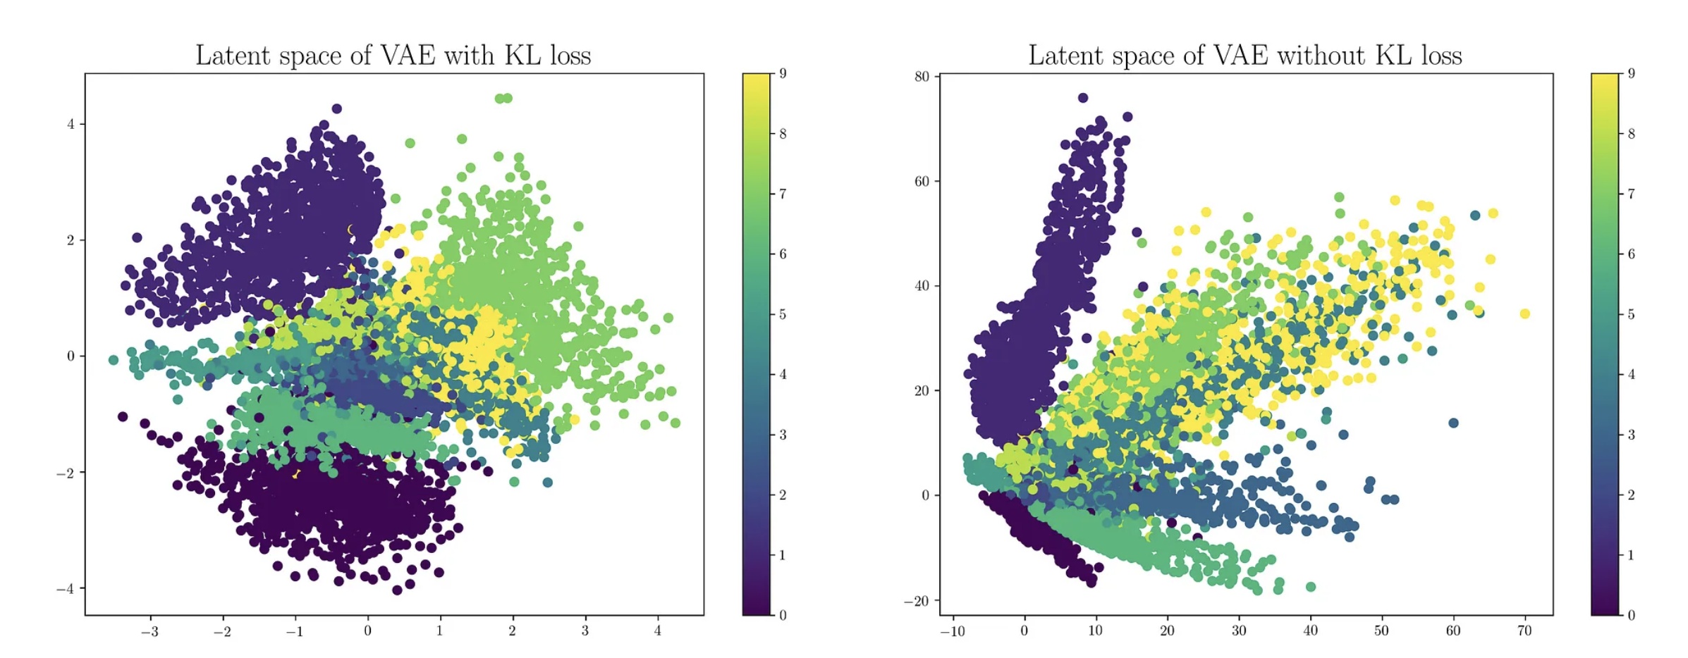
Loss Functions
The loss function is defined by the VAE objectives. VAE has two objectives
Reconstruct the input
Latent space should be normally distributed
Loss function = reconstruction loss+(similarity loss) KL Divergence loss

Slide 25
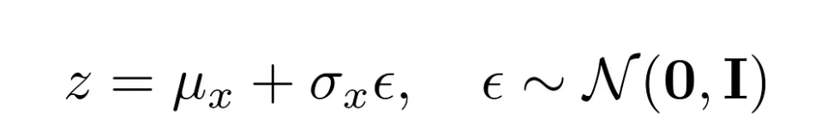
Loss Functions
The latent vector is sampled from the encoder-generated distribution before feeding it to the decoder.
This random sampling makes it difficult for backpropagation to happen for the encoder since it becomes difficult to trace the errors.
Reparameterization trick to model the sampling process which makes it possible for the errors to propagate through the network.
The latent vector z is represented as a function of the encoder’s output.

Slide 26
Example: MNIST
KL divergence term measures how different the learned distribution of the latent variables is from the prior distribution, which is usually assumed to be a standard normal distribution.
This regularization term helps the VAE to avoid overfitting and to learn a more robust latent space.
The objective of the VAE is to minimize the reconstruction loss, and the KL divergence loss
KL Divergence loss measures the difference between the learned distribution and the prior distribution.
Assume here prior distribution (mean =0 and variance =1) normal distribution
Learned distribution (if it is defined as mean =…. Variance=… ) bell distribution

Slide 27
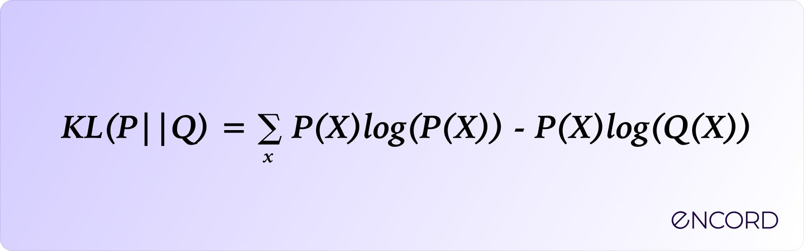
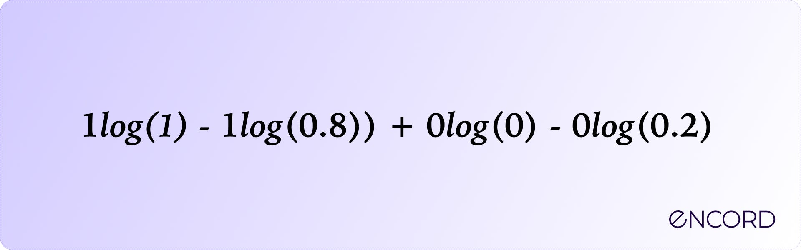
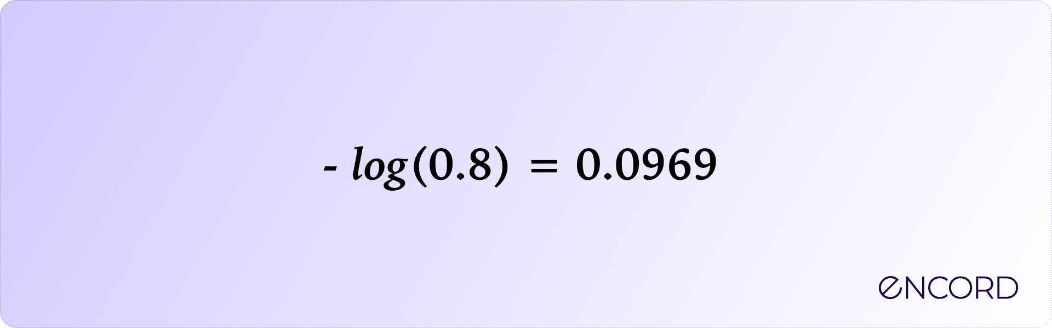
KL (Kullback –Leibler Divergence Loss)
KL divergence is an asymmetric divergence metric.
Asymmetric means that given a probability distribution P and a probability distribution Q, the divergence between P and Q will not be the same as Q and P.
a binary cat classifier predicts the probabilities for an image as p(cat) = 0.8 and p(not cat) = 0.2. If the ground truth of the image is that it is a cat, then the true distribution becomes p(cat) = 1 and p(not cat) = 0

Slide 28
Autoencoders training
Code size: The code size or the size of the bottleneck is the most important hyperparameter used to tune the autoencoder. The bottleneck size decides how much the data has to be compressed. This can also act as a regularisation term.
Number of layers: Like all neural networks, an important hyperparameter to tune autoencoders is the depth of the encoder and the decoder. While a higher depth increases model complexity, a lower depth is faster to process.
Number of nodes per layer: The number of nodes per layer defines the weights we use per layer. Typically, the number of nodes decreases with each subsequent layer in the autoencoder as the input to each of these layers becomes smaller across the layers.

Slide 29
Types of autoencoders
Undercomplete autoencoders
Sparse autoencoders
Contractive autoencoders
Denoising autoencoders
Variational Autoencoders (for generative modelling)

Slide 30
Undercomplete autoencoder
These autoencoders have smaller hidden dimensions in comparison to input.
This means that they excel at capturing only the most important features present in the data.
These types of autoencoders usually do not need regularization as they do not aim to reproduce outputs similar to inputs but rather rely on the compression stage to capture meaningful features in the data
Feature extraction is the main type of application for this type of autoencoders.

Slide 31
Sparse Autoencoders
Sparse autoencoders are controlled by changing the number of nodes at each hidden layer.
Since it is impossible to design a neural network with a flexible number of nodes at its hidden layers, sparse autoencoders work by penalizing the activation of some neurons in hidden layers.
It means that a penalty directly proportional to the number of neurons activated is applied to the loss function.

Slide 32
Denoising Autoencoders

Slide 33
Denoising autoencoders are similar to regular autoencoders in that they take an input and produce an output.
However, they differ because they don't have the input image as their ground truth. Instead, they use a noisy version.
It is because removing image noise is difficult when working with images.
But with a denoising autoencoder, we feed the noisy idea into our network and let it map it into a lower-dimensional manifold where filtering out noise becomes much more manageable.
The loss function usually used with these networks is L2 or L1 loss.
Focused on cleaning old stained scanned images or contribute to feature selection efforts in cancer biology.

Slide 35
Limitations of Autoencoders for Content Generation
Is it possible to create a new content?
The answer is “yes”, but the quality and relevance of generated data depend on the regularity of the latent space.
The latent space regularity depends on the distribution of the initial data, the dimension of the latent space, and the architecture of the encoder.
It is quite difficult to ensure, a priori, that the encoder will organize the latent space in a smart way compatible with the generative process
No regularization means overfitting, which leads to meaningless content once decoded for some point.
can we make sure the latent space is regularized enough? We can explicitly introduce regularization during the training process. Therefore, we introduce Variational Autoencoders.

Slide 36
Drawback of VAE
The biggest drawback of variational autoencoders is that they have a tendency to generate blurry, unrealistic outputs.

Slide 37
